Slide 1
De novo Genome Assembly and Annotation

Slide 2
Today’s Instructor
Brendan Jeffrey, Ph.D. Molecular and Cellular Biology
Bioinformatics and Computational Biosciences Branch (BCBB), NIAID
National Institutes of Health, Bethesda, MD USA
NIH - Rocky Mountain Labs, Hamilton, MT USA
Contact our team via email:
Listserv: ACE-GLOBAL-ANNOUNCE@list.nih.gov
Instructor: brendan.jeffrey@nih.gov

Slide 3
Outline
Introduction to genome assembly
De novo vs reference guided
Background of de novo assembly algorithm – De Bruijn Graphs
Hands on - genome assembly of Coxiella burnetii genome
Introduction to prokaryote genome annotation
Structural vs Functional
RAST and PGAP at NCBI
Hands on – submission to RAST

Slide 4
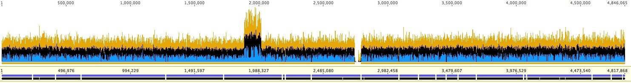
Reference Guided vs De Novo
Reference guided has a known genome sequence to align to

Slide 5
Reference Guided vs De Novo
De novo is assembling a genome sequence without a reference
?

Slide 6
Reference guided vs De novo
Reference guided
bowtie2
De novo
spades
First round assembly
Fill in gaps in reference guided assembly using de novo contigs

Slide 7



De Novo Assembly Applications
Applications
Novel genomes
Metagenomics
Variants
Transcriptomics
Trinity
Multi-National
NIH Human Microbiome Project
Oceanic Metagenomics Collection

Slide 8
Greedy Alignment
Assembly method used for Sanger sequencing – Cap3
TGAAAATGTAGCAGAAGATTGT
GATTGTCTCAAGAACGGACTTATTCTTGAGAGTGC
TCAAGAACGGACTTATTCTTGAGAGTGCTGCCCACAATGTTA
GCCCACAATGTTAGTGAGGTTGAACTT
TGAAAATGTAGCAGAAGATTGTCTCAAGAACGGACTTATTCTTGAGAGTGCTGCCCACAATGTTAGTGAGGTTGAACTT
Does not scale well computationally for Illumina sequencing

Slide 9
De Bruijn Graphs
Chaisson et al,
Genome Res. 2009. 19: 336-346

Slide 10
List of Assemblers
Short read - illumina
velvet
spades – useful for Prokaryote assembly
SOAPdenovo
Short and long reads – pac bio, ion torrent, and illumina
ALLPATHS-LG – useful for Prokaryote and Eukaryote assembly
Long reads - pac bio, ion torrent
Celera
Transcriptome
Trinity

Slide 11
Assembler Performance
Gurevich et al, Bioinformatics. 2013. 29: 1072-1075

Slide 12
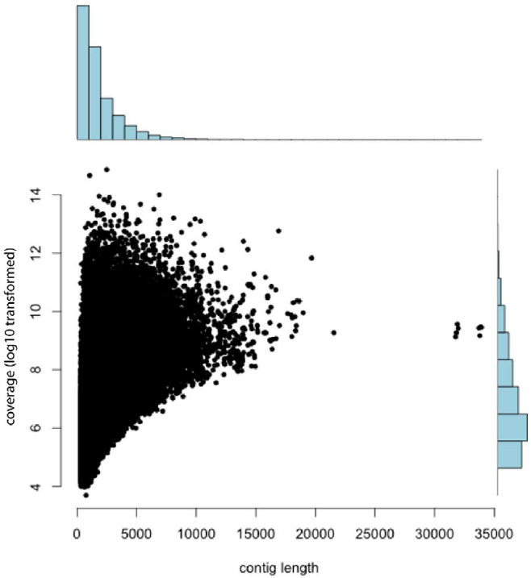
Good Assemblies
High coverage required
Sufficient read length
2 x 150 (hiseq)
2 x 300 (miseq)
Mate pairs – 5kb
QC
Low error rates
(read length bp) x (number of reads)
Coverage =
genome length bp

Slide 13
Issues with De Novo Assembly
Repeats
Eukaryotes have many repetitive regions
Sequence complexity
Homopolymers, di/tri-nucleotide repeats
ATATATATATATATATATATATAT
Polyploidy

Slide 14
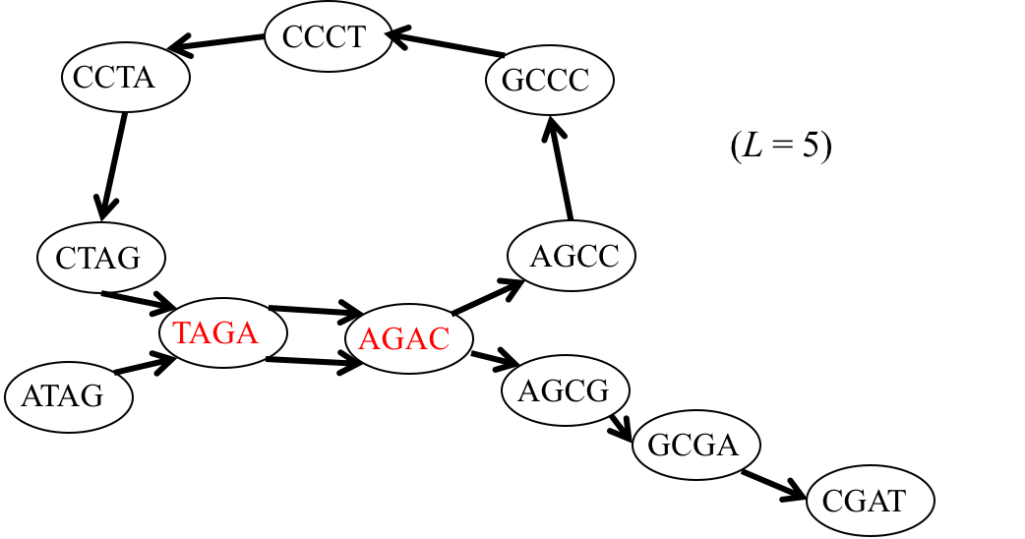
Genome Assembly Workflow
Isolate, library prep, sequence DNA
Coverage?
Sequencing QC
Spades
Construct assembly graph
Simplify assembly graph
Initial set of contigs
Detangle contigs if possible
Long reads
Mate pairs
Assembly QC
Quast – contig metrics

Slide 15
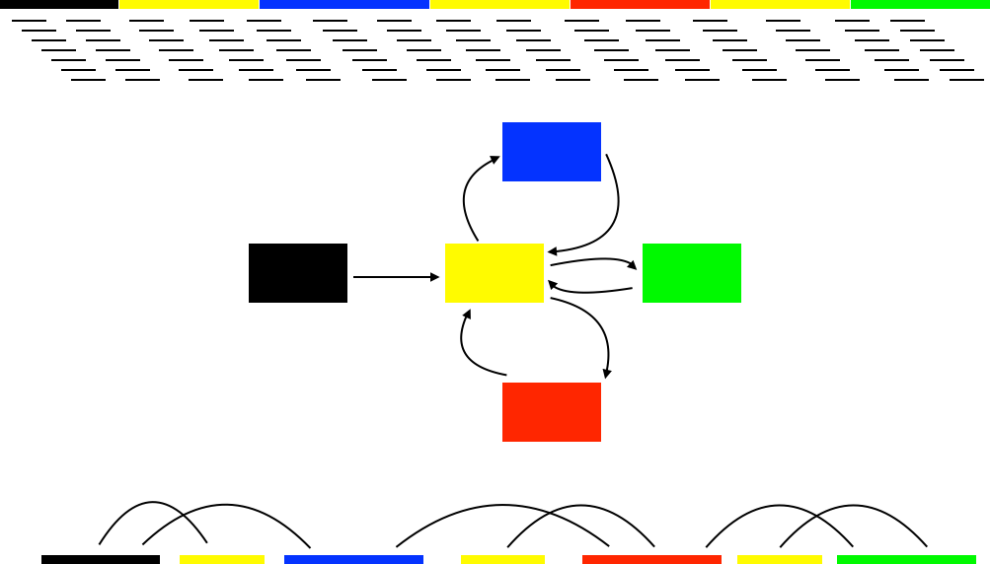
De Novo Approach
Short read - illumina
Spades

Slide 16
Scaffolding
Short read - illumina
Spades
ALLPATHS-LG
Long read – pac bio
mate pairs - illumina

Slide 17
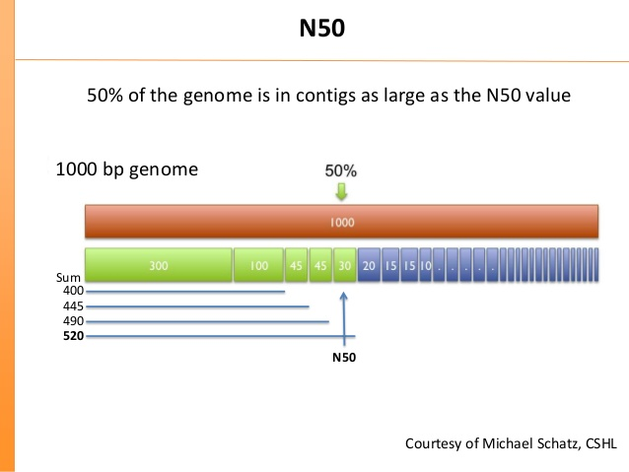
Quality of Assembly
N50 Definition – 50% of the genome is in contigs as large as the N50 value
Larger = better
Quast web server for assembly metrics

Slide 18
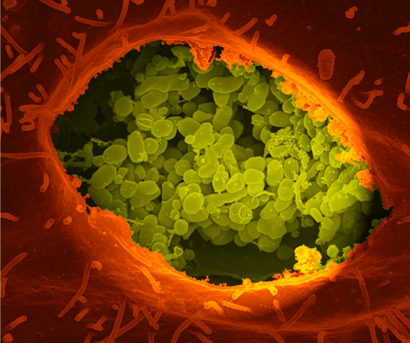
Hands on – De Novo Assembly
Gram-negative intracellular
Causative agent of Q-fever
Infection results from inhalation of aerosols from infected animal products
RSA-493 Nine Mile 1,995,275 base pairs

Slide 19
Genome Annotation
Process of identifying the location of genes and coding regions in a genome and determining what those genes do

Slide 20
Annotation - Basics
Two-step process
Structural annotation
Gene prediction, genomic landmarks
Functional annotation
Assigning a function or category from extracted sequence information from structural annotation

Slide 21
Structural Annotation
Identifying genes for protein coding (CDS) as well as non-coding
+3
GAA
ATG
TAG
GTT
+2
TGA
ATG
TAG
ATG
TAG
AGT
+1
ATG
TAG
6 frames
-1
CTA
CAT
-2
-3
Ab initio – gene callers rely on compositional features to distinguish protein coding from non-coding (GenemarkS, Glimmer)
Evidence based - compare the unknown ORF sequence against a database of genes or genomes, scoring ORFs that match the database above defined thresholds

Slide 22
Functional Annotation
Assigning function to putative genes
Representative RefSeq proteins
Prediction by alignment
Final Annotations
Put. ORFs
Reference Proteins by clade

Slide 23
Functional Annotation
RefSeq - NCBI's Reference Sequence project, is a non-redundant, annotated set of sequences that serve as reference standards. They are derived from the INSDC databases and include chromosomes, complete genomes (plasmids, organelles, viruses, archaea, bacteria, and eukaryotes), intermediate assembled genomic contigs, curated genomic regions, mRNAs, RNAs, and proteins

Slide 24
Annotation Tools
Gene finding (structural)
GeneMarkS
Glimmer
Prodigal
tRNAscan-SE
Rfam
RNAmmer
Functional
Blast
Comparing sequence to databases
All in one tools
RAST
NCBI

Slide 25
NCBI PGAP

Slide 26
NCBI PGAP
RefSeq - NCBI's Reference Sequence project, is a non-redundant, annotated set of sequences that serve as reference standards. They are derived from the INSDC databases and include chromosomes, complete genomes (plasmids, organelles, viruses, archaea, bacteria, and eukaryotes), intermediate assembled genomic contigs, curated genomic regions, mRNAs, RNAs, and proteins

Slide 27
NCBI PGAP

Slide 28
NCBI PGAP

Slide 29
RAST

Slide 30
RAST - Subsystems
In an initial stage, an expert in a biological topic integrates what is known from the literature producing a set of expert assertions, which include the assertions from the literature, as well as a far broader set based on judgement and extrapolation.
Bioinformatics tools are developed to project structured collections of expert assertions (rather than just the wet lab results captured in the literature) to new genomes.
Aziz et al. BMC Genomics 2008. 9:75

Slide 31
RAST
tRNAs (tRNAscan-SE) and rRNAs
Initial estimate structural calling GLIMMER2 - putative
Use small number of FIGfams (~10 genes)
Search new genome for these representative genes, find nearest neighbor genomes
Using FIGfams from neighbors, search new genome. Putative genes to determined genes
Use determined genes (~90%) as training set to re-call genes in new genome
New putative genes are compared to ALL FIGfams
BLAST remaining putative to non-redundant, leftover are hypothetical

Slide 32
Hands on - annotation
Submit de novo assembled genome to RAST server
Compare RAST annotation vs PGAP
Briefly view RAST server contents
Seed viewer

